Slide 1
Green ICT

Slide 2
Did You Know……..
The global information and communications technology (ICT) industry accounts for approximately 2 percent of global carbon dioxide (CO2) emissions, a figure equivalent to aviation" - Gartner 2007.
18% of office workers never switch off their PC at night or weekends, and a further 13% leave it on some nights each week, producing about 700,000 tons of CO2 emissions (equivalent to the annual emissions of a typical gas-fired power station) - World Economic Forum Green Technology 2009 Report

Slide 3
Did You Know……..
A photocopier which is left switched on overnight needs the same amount of energy as it does to make 1500 photocopies. [Experton 2007]
With the fast growth of ICT application in business operation and people’s daily life, the total electricity consumption of ICT and other consumer electronics worldwide is predicted to double by 2022 compared to the level in 2010, while tripled by 2030 to 1,700 tera (trillion) watts – Gadgets and Gigawatts: Policies for Energy Efficient Electronics

Slide 4
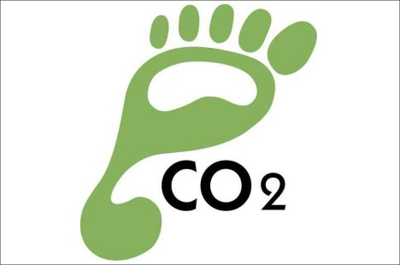
Did You Know……..
The total footprint of the ICT sector – including personal computers (PCs) and peripherals, telecoms networks and devices and data centres –
was estimated at 830 MtCO2e,
about 2% of the estimated total
emissions from human activity in 2007.
Even if the efficient technology
developments are implemented,
this figure seems to grow at 6% each year until 2020. - SMART 2020 Report

Slide 5
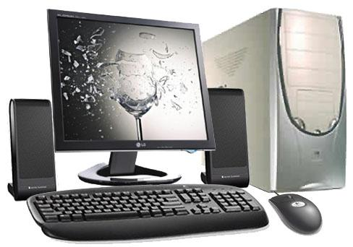
Did You Know……..
At least 240 kilograms of fossil fuels, 22 kilograms of chemicals and 1,500 kilograms of water are required to produce one desktop computer. - Computer Aid International
Only 20 percent of total energy use goes into running a computer; the rest is in its manufacture. - Computer Aid International

Slide 6
Greener Computer use

Slide 7
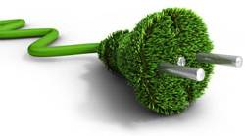
Tips for Greener Computer use
1 Turn off your computer sets (CPU, monitor,
printer and peripherals), when not in use –
as this will save energy.
2 Plug your computer into a surge protector with a master control outlet, which automatically senses when the computer is not in use and cuts power to it and all your peripherals.
3 Enable the standby/sleep mode and power management settings on your computer.
4 Avoid using screen savers because it does not reduce energy use.
5 Configure your printer settings to economy mode as this will save ink and energy

Slide 8
Tips for Greener Computer use
6 Reuse and repair ICT equipment before replacing.
7 Choose dark backgrounds for your screen display—bright-colored displays consume more power.

Slide 9
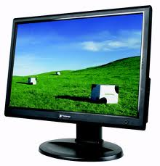
Tips for Greener Computer use
8 Use LCD monitors instead of CRT as they provide up to 70% power savings. The smaller the size of a LCD monitor, the lesser the energy it consumes.
9 Purchase an Energy Star–compliant computer. Note that laptop models use much less energy than desktop units.
10 Buy multi-functional equipments for tasks such as printing, faxing, copying and scanning as multi-functional equipments save up to 50% in space and 20% in energy.
11 Buy inks which are made from renewable resources (e.g. vegetable and non-petroleum products), as it uses less hazardous solvents, and also produce brighter, cleaner colors.
12 Consider switching to thin client machines and notebooks as these equipments use less energy than desktop PCs.

Slide 10
Tips for Greener Computer use
13 Read and review documents and e-mails on screen instead of printing on papers
14 Buy and use recycled paper for your printers and copiers.
15 Use double-sided printing functionality of your printer to save paper and energy.
16 Use scanned documents instead of printed documents.
17 Use e-mail, instant messaging (e.g. Skype) and e-services such as online banking instead of traditional form of communication.

Slide 11
Green Printing Guidelines

Slide 12
Green Printing Guidelines
Reduce your paper use.
Lower consumption by emailing drafts, notes, and newsletters instead of printing them.
Edit documents online instead of printing drafts.
Reduce your margins when printing
No Goldenrod, Fluorescents, or bright-colored paper.
One important way to reduce waste is to print on recyclable paper.
Many people don’t know that Goldenrod, Fluorescents, and bright colors are not recyclable because of the strong dyes used to make them.
For your next meeting or event, please choose paper that is recyclable.
Printer Use.
Use recycled toner cartridges for laser printers.
Print double sided and on 100% post-consumer paper.
Turn off the printer when not in use.

Slide 13
Top 10 Ways to Reduce Power Consumption of PCs

Slide 14
Top 10 Ways to Reduce Power Consumption of PCs
Use computer and monitor power management. Doing so can reduce carbon emissions and energy costs.
Don’t use a screen saver. Screen savers are not necessary on modern monitors and studies show they actually consume more energy than allowing the monitor to dim when it’s not in use.
Buying a new computer? Make energy efficiency a priority while shopping for your PC and monitor. Look for the ENERGY STAR label www.epeat.net or browse the Climate Savers Computing product catalogue. www.climatesaverscomputing.org/resources/product-catalog

Slide 15
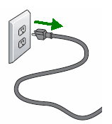
Top 10 Ways to Reduce Power Consumption of PCs
Turn down the brightness setting on your monitor. The brightest setting on a monitor can consume twice the power used by the dimmest setting. Note that on most laptop computers, the display is the single largest consumer of energy.
Turn off peripherals such as printers, scanners and speakers when not in use.
Fight phantom power; plug all your electronics into one power strip and turn the strip off when you are finished using your computer. When feasible, we also recommend unplugging the power strip from the wall to avoid high voltage surges which may occur during an electrical storm.

Slide 16
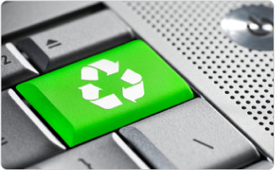
Top 10 Ways to Reduce Power Consumption of PCs
Use a laptop instead of a desktop. Laptops typically consume less power than desktops.
Close unused applications and turn off your monitor when you’re not using it.
Use a power meter to find out how much energy your computer actually consumes and to calculate your actual savings.
Establish multiple power schemes to address the different ways you use your computer. For example, you can create a power scheme for playing music CDs that shuts off your hard drive and monitor immediately, but never puts your system into standby mode

